Slide 1
NYC
Property
Report
PRESENTED BY
Carl Jason Tondo
Hekwang Lhi
Khalid Ettalii
Maria Jose Siles Navarro

Slide 2
Data Housing Agenda
01
Data Source
Relevance of NYC property Data in today’s world
02
Data Engineering
Cleaning and Transforming the NYC Property data
03
Data Modeling
Training and Testing with Machine Learning for data predictions
04
Conclusion | Q&A
What did we learn? How can we improve? General Q&A

Slide 3
Goals
“How can we provide extensive resources for future property owners?
Visualizations
Data Source
A) Bring clarity to data
B) Highlight visual insights
C) Be able to mark outliers
A) Source of Data is trustworthy
B) Clean data by dropping outliers
C) Extraction of relevant data
Support Decision Making
Modeling Relevant Data
“Am I ready to purchase property?”
“Which types of units are the least or most expensive?
“Which borough will be the hottest purchase for 2020?”
A)Utilization of machine learning for predictions of potential data
B) Shape data to derive a model.
NYC Realty
Group

Slide 4
Data Sources
About the Dataset
- Our dataset comes from two Kaggle datasets
- First dataset is called “NYC Property Sales” and provides features (18) such as: Year Built, Sale Price, Total Units, etc. This dataset involves properties sold in New York City over a 12-month period.
- Second dataset is called “House Prices” and provides many more features such as: # of Bedrooms/Baths, Lot Area, Sale Price, Sale Type, Sale Condition, etc. This dataset involves house features (80) that can have potential correlations between each other.
Example: Finding a correlation between
Sales Price and Lot Area using Machine
Learning (Linear Regression) and Distribution
Insert the title of your subtitle Here]

Slide 5
NYC Property Data Chart
Insert the title of your subtitle Here]

Slide 6
Dataset Processing steps
NYC Realty Group
Data Extraction
Data Organization
First Cleaning
01
Be able to choose a trustworthy site for dataset and observe relevant data for extraction
02
Group data by its data type. Dividing the data into numerical (“Quan”) and categorical (“Qual”) data
03
Dropping irrelevant columns. Determine the count of null values for the numerical and categorical features.
Describe & Second Clean
Machine Learning & Visuals
Results and Observations
04
Calculate descriptive statistics of dataset. Categorical features can be ordered by "rank", so they can be transformed into numerical features
05
Utilization of training and testing data to determine significant predictions.
visualize the distribution of each numerical feature
06
Gain insight on any significant trends made out from the visualized data. Discover any correlations between features

Slide 7
Data Descriptions and Base Visualizations

Slide 8
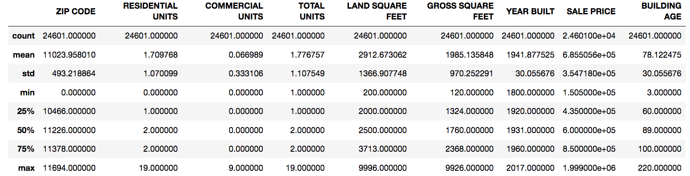
NYC Property Descriptive Statistics

Slide 9
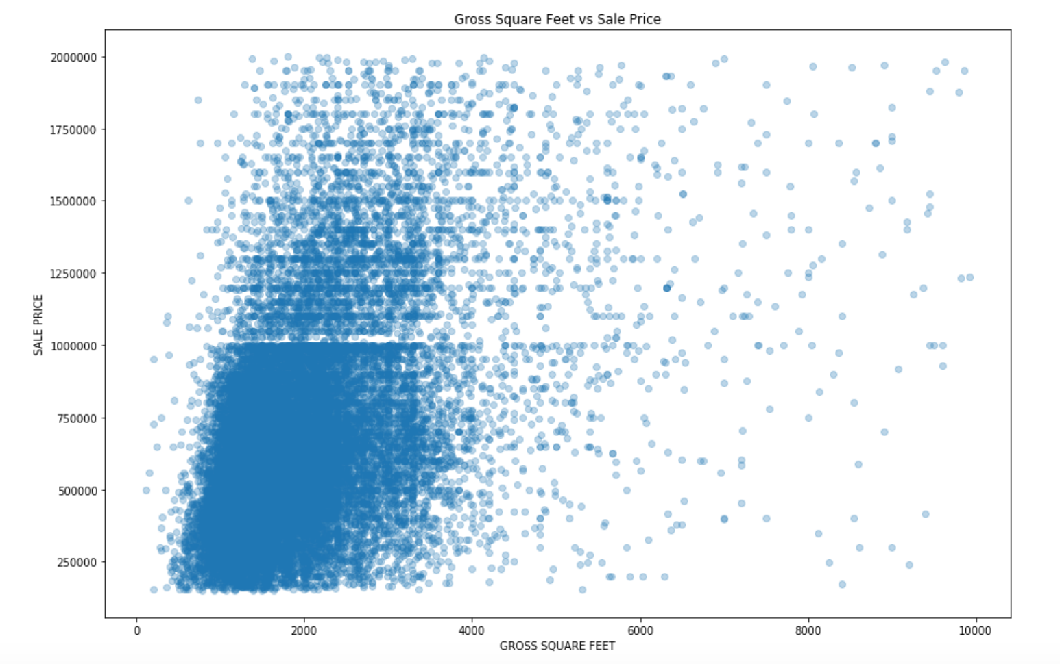

Slide 10
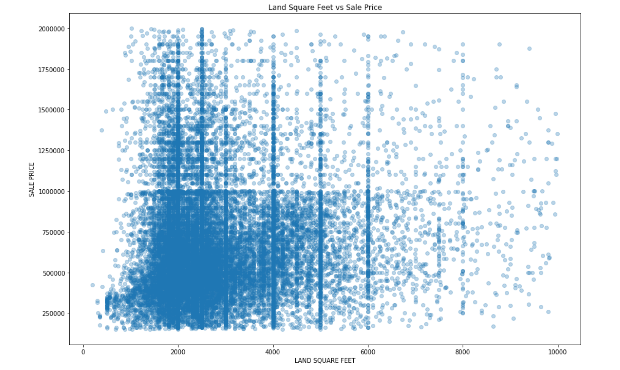

Slide 11
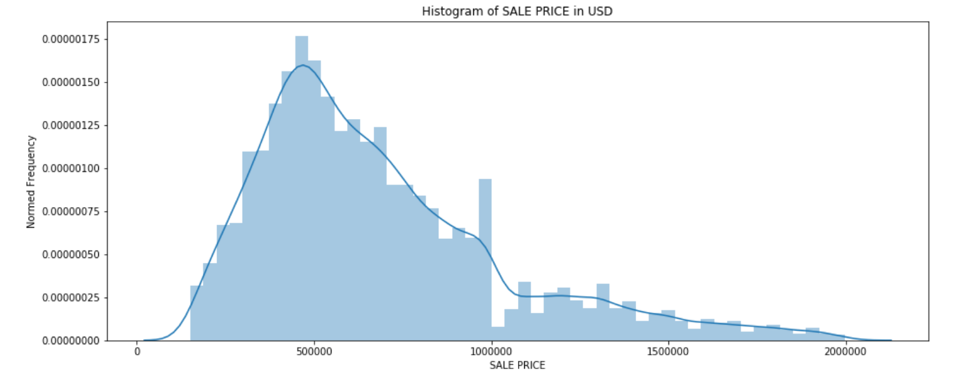

Slide 12
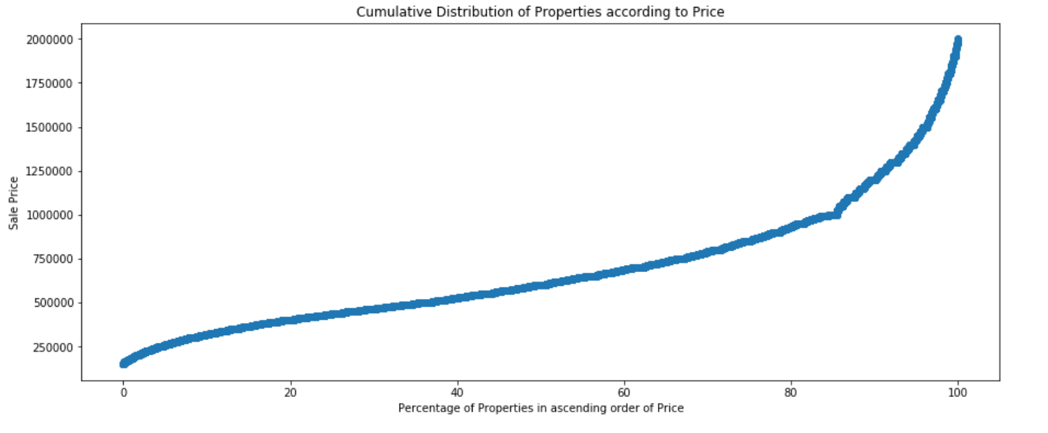

Slide 13
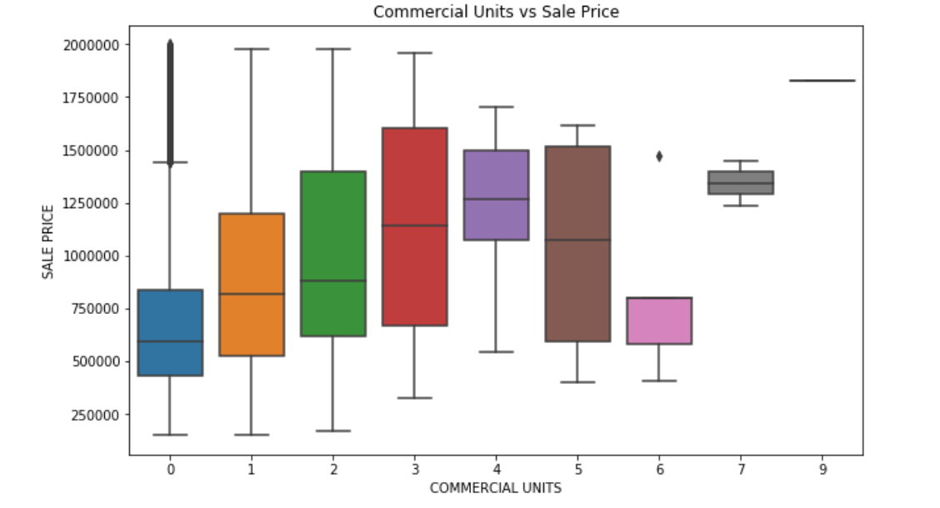

Slide 14
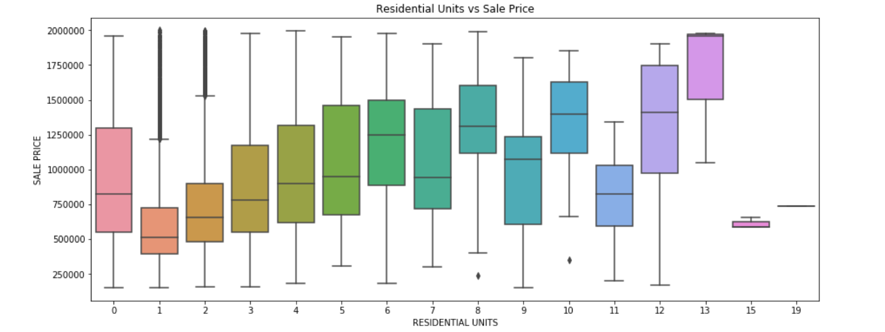

Slide 15
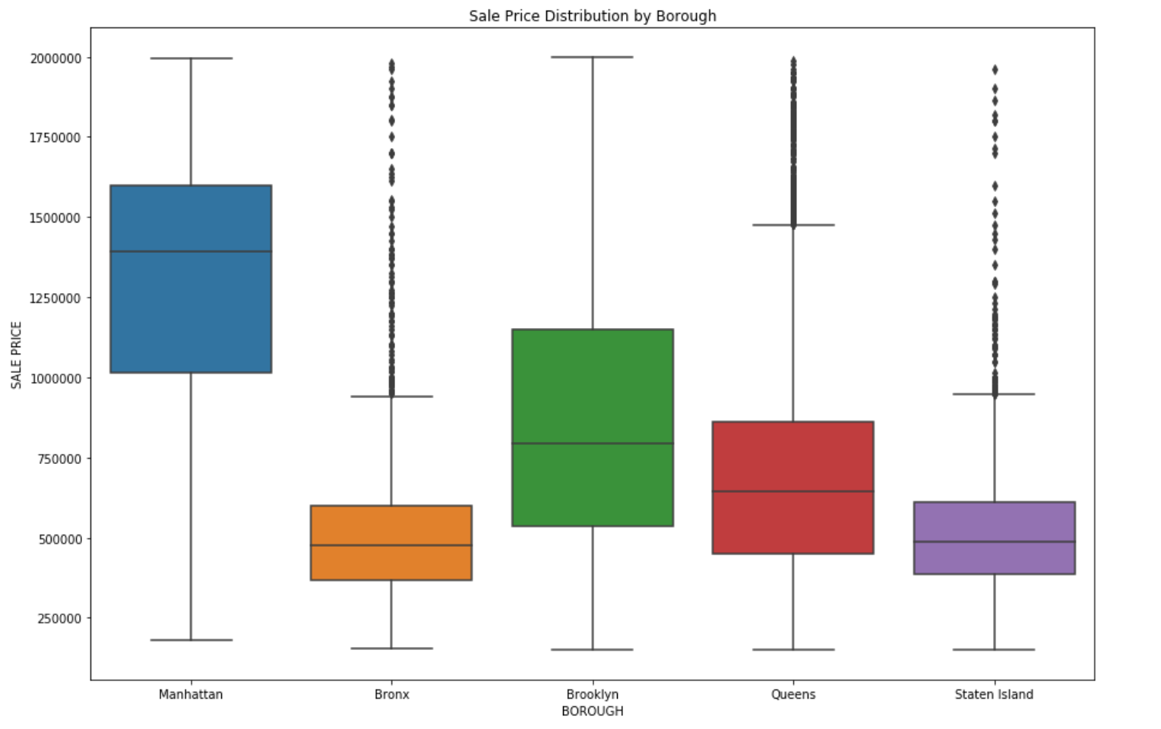

Slide 16
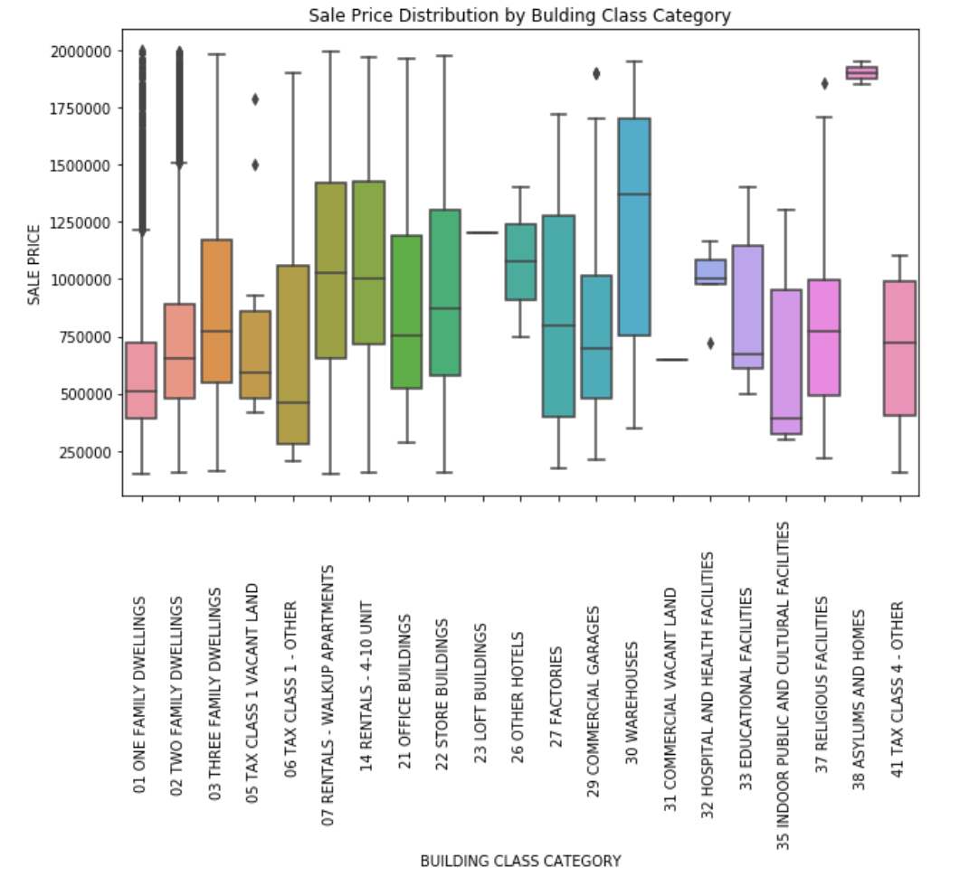

Slide 17
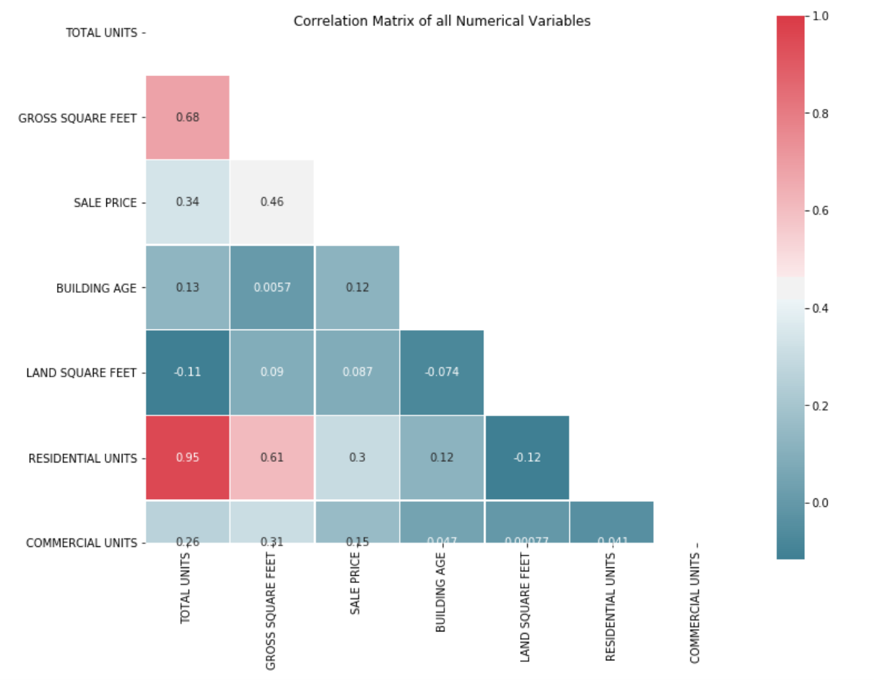

Slide 18
Visual Distribution of Numerical Features

Slide 19
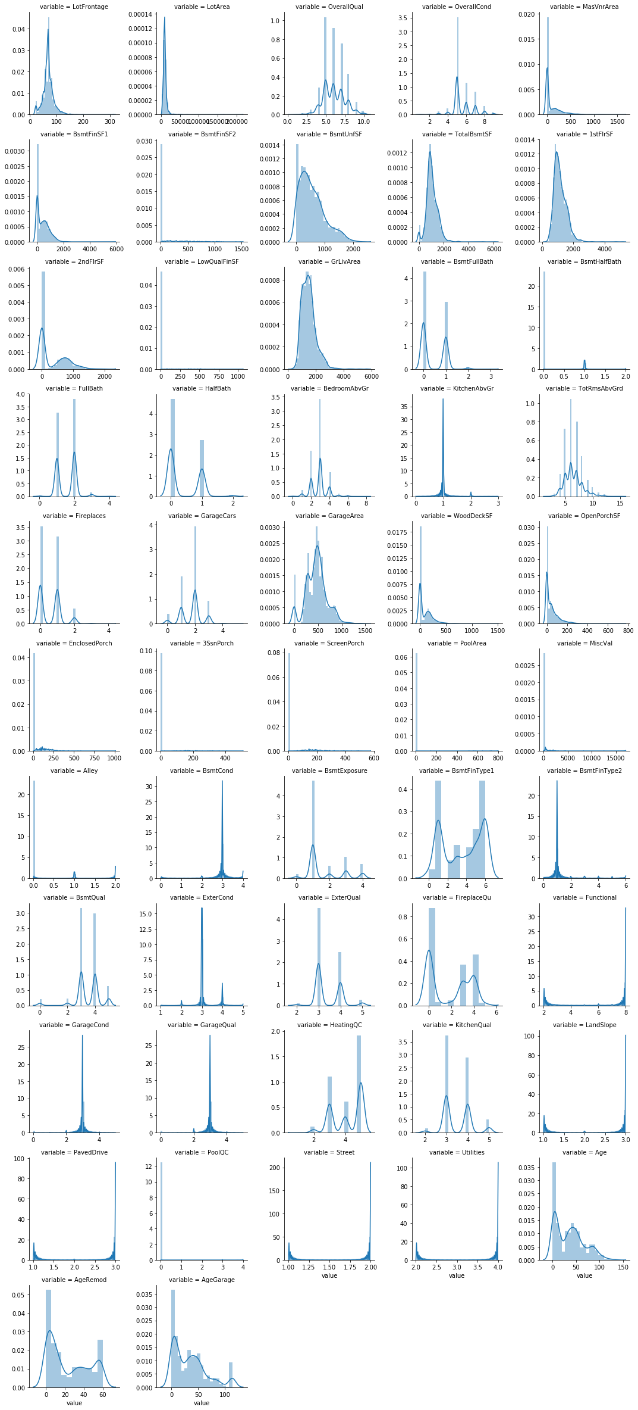

Slide 20
Scatter Plots of Numerical Features

Slide 21
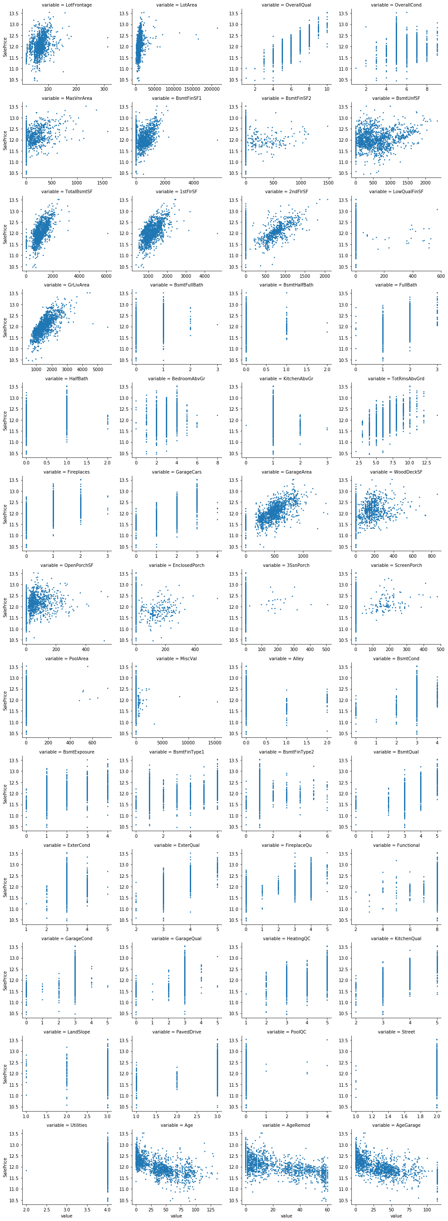

Slide 22
Scatter Plots Explained
Correlation Insights
We see correlations in the scatter plots for some features, such as LotFrontage, LotArea, TotalBsmtSF...etc. There are some obvious outliers in some of these plots. By removing some outliers in the training set, the model will generalize better on unseen data.
After removing the outliers it is necessary to transform the numerical features that are skewed. This is because lots of regression models building assume that the features are distributed normally and have a symmetrical shape.
We’ve tried various transformations (log, boxcox, sqrt...etc) and found that log-transform works better.
We transform those with skewness > 0.5, and we get to change the visualization of the scatter plots.
.

Slide 23
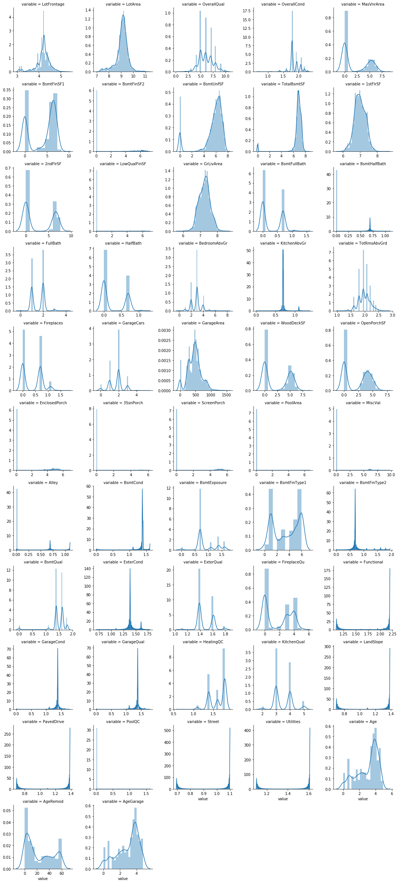

Slide 24
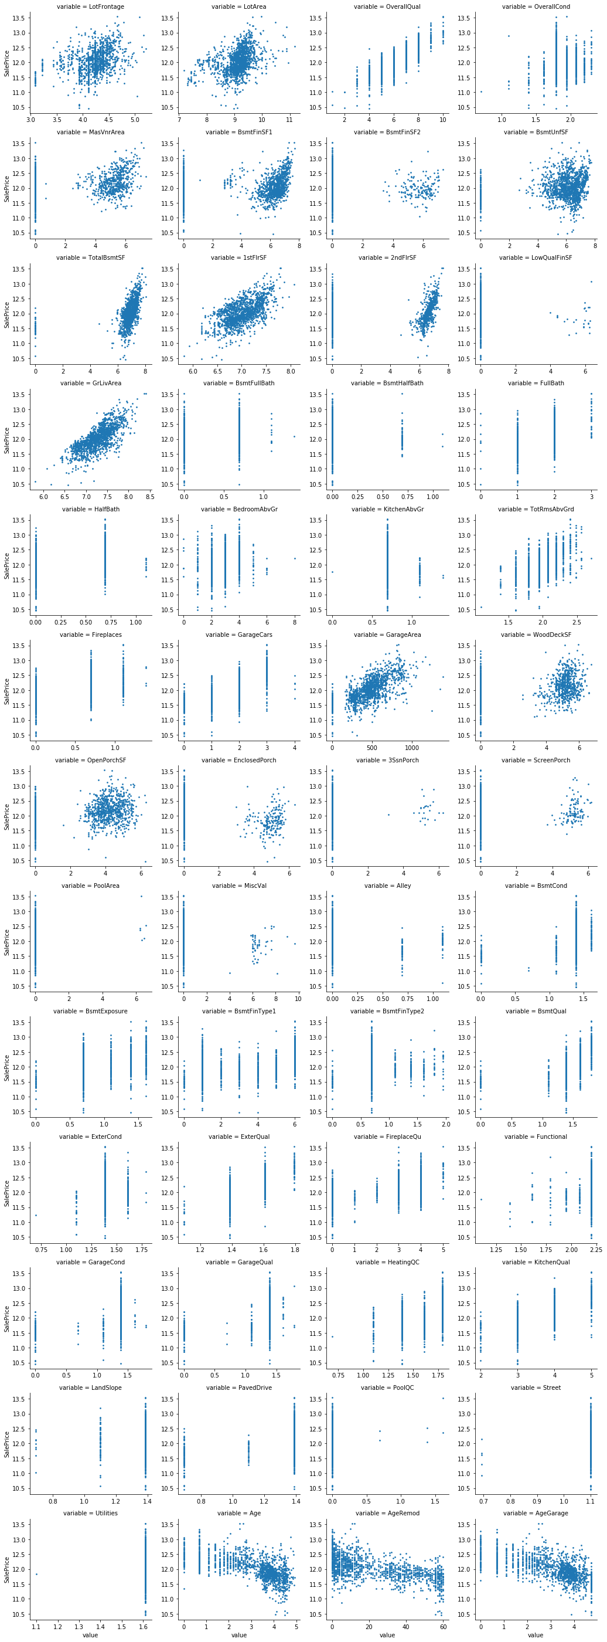

Slide 25
Machine Learning (ML)

Slide 26
Linear Regression
In this project , we used the XGBoost Regressor along with RFECV (Recursive Feature Elimination) to rank the importance of the features and eliminate the redundant ones. I then trained a Kernel Ridge regressor (which performed best among the several models I tried) to make predictions, which leads to a leaderboard score of 0.11709.
For the categorical features, I will transform them to dummy variables, but I'll drop one column from each of them to avoid dummy variable trap.
.

Slide 27
Recursive Feature Elimination (RFECV)
After we can split the data into training set and test set. And then we'll perform Standardization on the numerical features (those that are not dummy variables). Here we use RobustScaler instead, which is more robust to outliers in the data.
Now there are 220 features due to a large amount of the dummy variables. Overfitting can easily occur when there are redundant features, which also leads to longer computation time. Therefore, we use XGBoost regressor to generate the rank of "feature importance”
In the end we can use RFECV to eliminate the redundant features.
Those are the most importance feature we get after we use RFECV
array(['1stFlrSF', 'BsmtExposure', 'BsmtFinSF1', 'BsmtFinType1',
'BsmtQual', 'ExterQual', 'FireplaceQu', 'Functional', 'GarageArea',
'GarageCars', 'GarageCond', 'GarageQual', 'GrLivArea', 'HalfBath',
'KitchenAbvGr', 'KitchenQual', 'LotArea', 'OverallCond',
'OverallQual', 'TotalBsmtSF', 'WoodDeckSF', 'Age', 'AgeRemod',
'MSZoning_C (all)', 'MSZoning_RL', 'MSZoning_RM',
'Neighborhood_Crawfor', 'Neighborhood_OldTown',
'Neighborhood_Sawyer', 'Condition1_Artery', 'Exterior1st_BrkComm',
'Heating_Grav', 'CentralAir_Y', 'GarageType_Attchd',
'GarageType_Detchd', 'SaleType_New', 'SaleCondition_Abnorml',
'MSSubClass_class2'],
.

Slide 28
Conclusion & Prediction

Slide 29
Modeling and Prediction
Kernel Ridge regressor is the model that performed best among the several models (XGBoost, Neural Network, Random Forest...etc) we have tried. Here I tune its hyperparameters using RandomizedSearchCV
Parameters of the best_estimator:
{'alpha': 0.44725674716804203, 'coef0': 3.9974729787275987, 'degree': 2, 'kernel': 'polynomial'}
Mean cross-validated RMSE of the best_estimator: 0.11351751593503093
RMSE of the whole training set: 0.09933518141866216
.

Slide 30
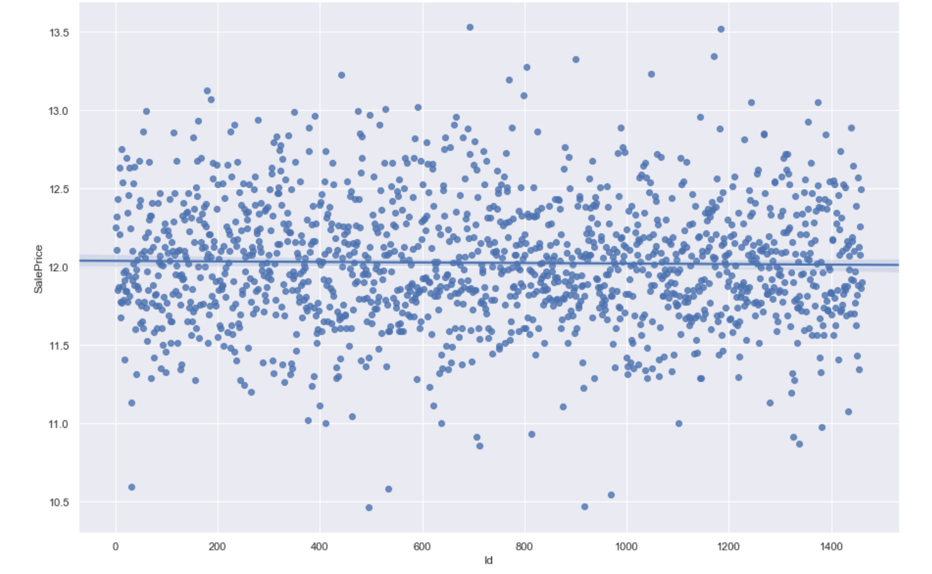

Slide 31
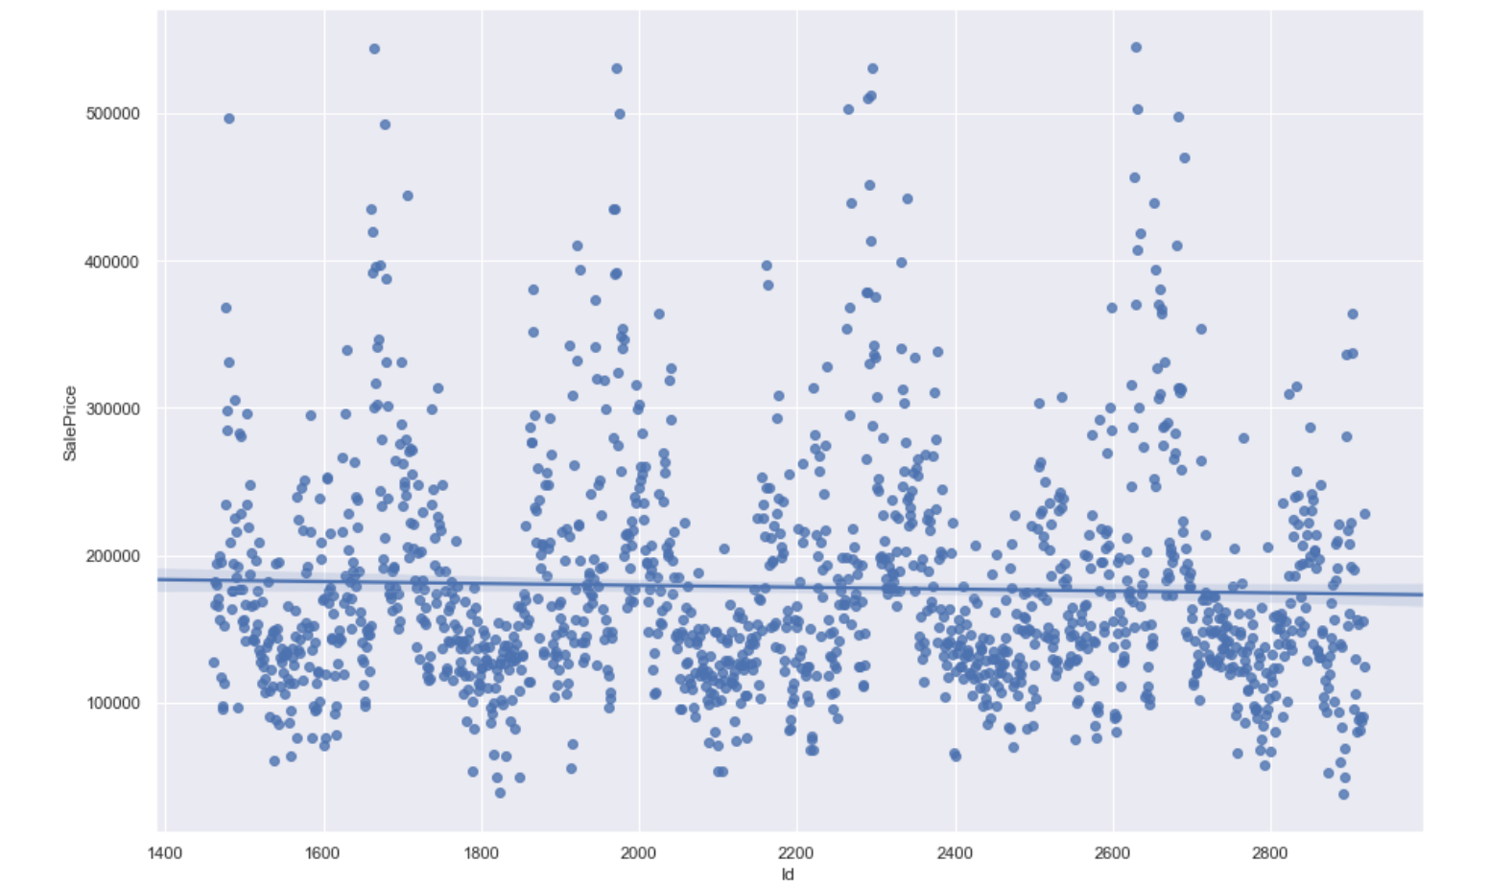

Slide 32
Questions?
Insert the title of your subtitle Here

Slide 33
Thank you

